Slide 1
OBI Workshop
Philly Oct 12-14, 2011
Melissa Haendel
Matt Brush
Carlo Torniai
Chris Mungall

Slide 2
Classification of Cells
CL:cell
The root of the Cell Ontology – references any cell.
“Anatomical structure that has as its parts a maximally connected cell compartment surrounded by a plasma membrane.
CL:cell in vivo
No definition
GO:cell – “The basic structural and functional unit of all organisms. Includes the plasma membrane and any external encapsulating structures such as the cell wall and cell envelope.”
CARO:cell - “An anatomical structure that has as its parts a maximally connected cell compartment surrounded by a plasma membrane.
OBI - Mireoted CL:cell and CL:cell line cell, but cell line cell not type of cell.
Potentially change the Mireoted CL:cell to CL:cell in vivo?
Equivalent: CL:cell in vivo== GO:cell== CARO:cell ??

Slide 3
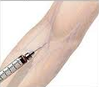


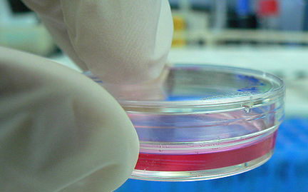
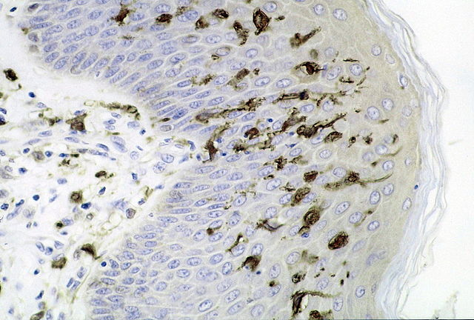
Experimentally modified cell
Classification of cells in experiments
part_of
part_of
Specimen collection
establishing cell culture
cell subculturing
cell culture
cell line
part_of
has_grain
has_grain
cell in vivo
cell ex vivo
Cell culture cell
cell line cell
cell in vitro
Notes:
Cell culture by kaibara87 (originally posted to Flickr as Cell Culture) [CC-BY-2.0 (www.creativecommons.org/licenses/by/2.0)], via Wikimedia Commons

Slide 4
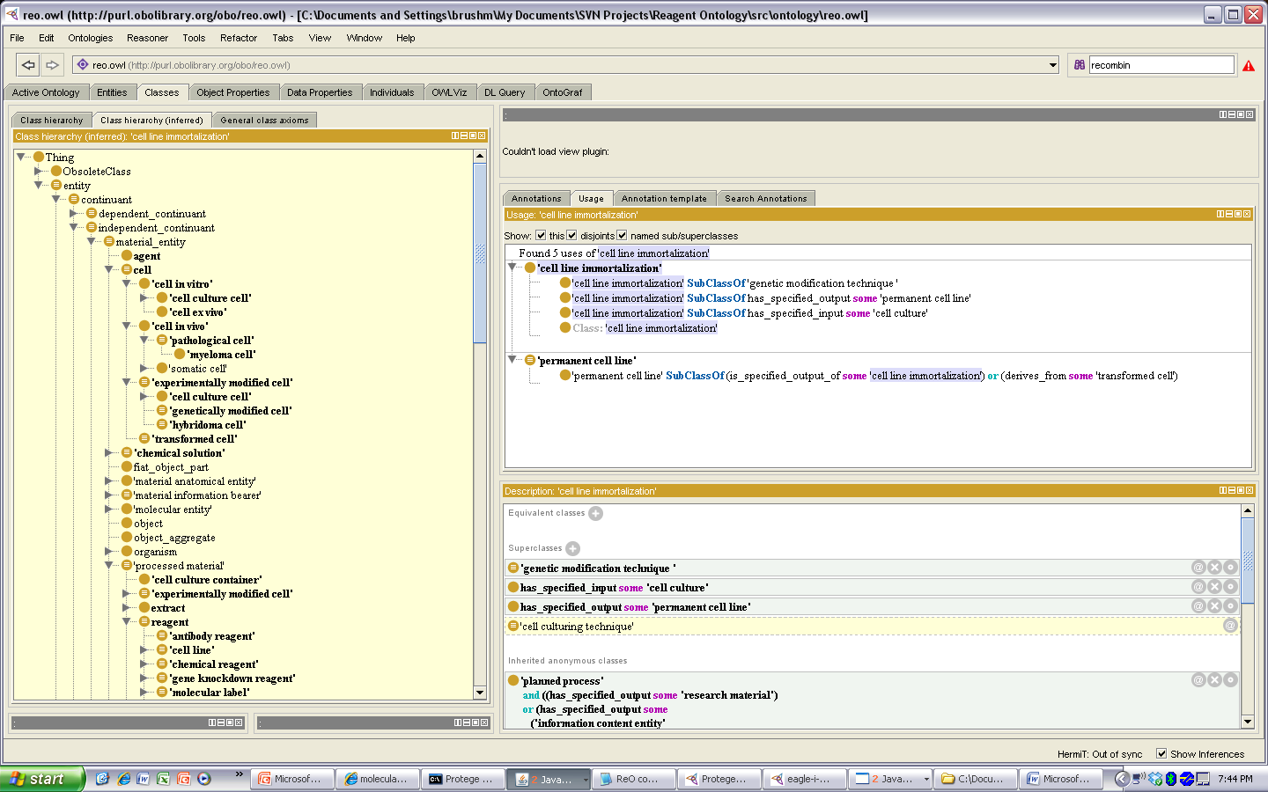
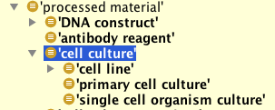
Classification of cells in experiments
CL:experimentally modified cell: A cell that has been changed as a consequence of a deliberate and specific experimental procedure.
(not necessarily in vitro)
CL:cell line cell – no definition.
OBI:cell line cell - “A material entity that
represents generations of a primary culture.”
ReO
REO: cell culture cell – “A cell that is part of some cell culture.
REO: cell culture- "a cell culture is a material entity consisting of a population of cells that is maintained
in vitro”
CLO:cell line – ‘A cell line is a permanently established cell culture that will proliferate indefinitely given appropriate fresh medium and space.
How to deal with cells in OBI that are experimentally modified based on the processes for which they are outputs? For example, OBI:lymph node cell which has been processed relative to an in vivo cell type that would be in CL. Is it a CL:lymph node cell with restriction of being processed? What is the relationship between two such cells? One of reference? Derivation?

Slide 5
Classification of Organisms
CARO:organism - “An individual member of a species.” (currently asserted as type of anatomical structure)
OBI:organism – "A material entity that is an individual living system, such as animal, plant, bacteria or virus, that is capable of replicating or reproducing, growth and maintenance in the right environment. An organism may be unicellular or made up, like humans, of many billions of cells divided into specialized tissues and organs.”
CARO: organism or virus or viroid – “Material anatomical entity that is a member of an individual species or is a viral or viroid particle.”
OBI Organism == CARO:organism or virus or viroid ??

Slide 6
Classification of Anatomical structures
OBI: Anatomical Entity- “An anatomical entity is a material entity that is part of a multicellular organism, and which is large enough so that it forms an identifiable structure in the organism. Specifically, it excludes granular parts of the organism, such as atoms, molecules, cells, which can be removed from the organism without affecting it. It is defined as the union of 'multi-tissue structure', 'body substance' and 'portion of tissue’.”
CARO:Anatomical entity: Biological entity that is either an individual member of a biological species or is part_of or located in an individual member of a biological species.
CARO: Gross Anatomical part: Anatomical structure that is part of a multicellular organism and is at the gross anatomical level, e.g. above the level of a cell. Included are portions of organism substances such as blood, multi-cell-part structures such as axon tracts, acellular anatomical structures such as hair, and organism subdivisions such as head. Excluded is the whole organism and more granular parts of the organism, such as atoms, molecules, macromolecular complexes and cells.
OBI Anatomical entity == gross anatomical part??

Slide 7
CARO: gross anatomical part
Currently includes:
CARO:multicellular anatomical structure: tissues and up.
CARO:Organism subdivision: this are the gross regions of an organism, the sum of which add up to the whole organism.
CARO:Acellular anatomical structure: things produced by cells but not containing any, such as cuticle, hair.
CARO:portion of organism substance:(things that are material but do not have 3D shape, such as bodily fluids.
CARO:multi-cell-part structure: things that are made up of parts of cells, such as axon tracts, synapses.
Should include:???
CARO:Extraembryonic tissue: consists of tissues and cells that don’t contribute to embryo. Currently includes cells.
CARO:anatomical group: disconnected structures such as the immune system, which are grouped by function.

Slide 8
Uberon integrates anatomical ontologies
B
anatomical structure
is_a (SubClassOf)
part_of
develops_from
endoderm
capable_of
organ part
is_a (taxon equivalent)
only_in_taxon
foregut
swim bladder
organ
endoderm of forgut
NCBITaxon:
Actinopterygii
respiration organ
respiratory primordium
GO: respiratory gaseous exchange
pulmonary acinus
alveolus
lung
lung primordium
NCBITaxon: Mammalia
alveolus of lung
alveolar sac
lung bud
FMA: pulmonary alveolus
FMA:lung
MA:lung alveolus
MA:lung
EHDAA:
lung bud
Notes:
uberon-combined-mammal.owl - shows you what you get with the bridge axioms

Slide 9
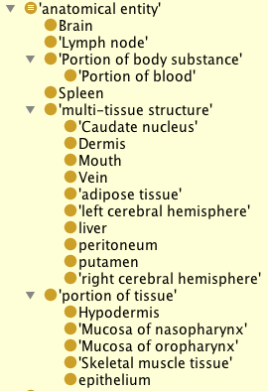
UBERON cross-species anatomy
Having an official release any day now..
Info at Uberon.org
Will use new CARO as upper ontology once released
Using UBERON in OBI
Some anatomy classes in OBI are currently from FMA but are not being used for definitions of human specific investigations. These could be replaced by the appropriate Uberon class. Others are defined in OBI but are in Uberon, could also be replaced.
Can leverage some of the relations in Uberon, even some simple things like ‘caudate nucleus being part_of some brain’.
eagle-i is using Uberon similarly- one can specify the general uberon class and then limit by taxon when needed. This is great for anatomical bits of species for which no anatomy ontologies exist.

